Slide 1

Energy Analysis Modules
Energy Analysis Reports and Energy Analysis Dashboard Software Modules
EcoBuilding - Power Solutions

Slide 2





We have an opportunity to co-create the future
as the new energy world becomes
More
ELECTRIC
2X
faster growth of electricity demand compared to
energy demand by 2040
More
DIGITIZED
10X
more connected devices
than people by 2025
More
DECARBONIZED
82%
of untapped energy efficiency potential in buildings
(and more than 50%
in industry)
More
DECENTRALIZED
70%
of new capacity additions will be renewable forms
by 2040
Source: IEA WEO 2014
Source: United Nations, IHS
Source: World Energy Outlook 2012
Source: BNEF
Notes:
Major trends are fundamentally changing power distribution — which means the systems we use to manage it must change too.
Today, the world is more electric, digitized, decarbonized, and decentralized – which brings both challenges and opportunities that will continue to grow and accelerate in the coming decades.
By digitization we mean chiefly the Internet of Things. In fact, by 2020, there will be 10 times more incremental connected devices than connected people. This, by the way, brings with it a lot more electricity consumption, to facilitate the data exchange involved in downloading videos and images, sending and receiving information, etc. It’s a big deal.
The decarbonization side is where we can make the savings: 82% of the economic potential of energy efficiency in buildings, and more than half in industry, remains untapped.
In terms of decentralization, did you know that close to 60% of consumers today are considering becoming power self-sufficient in the future? This is the exciting world of the “prosumer” — of microgrids and storage. One of our buildings in Paris will even be an energy-positive structure, which is an exciting trend for the future.

Slide 3

How power distribution has changed
Traditional power distribution model
Generation
Transmission
Distribution
Customer
New power distribution model
Demand response
Generation
Transmission
Smart Grid
Energy efficiency
Distributed generation
Notes:
While traditionally power has moved from a single source to the end customer, today it’s not so linear. Alternative energy sources and advances in technology mean that power is coming from many different places, energy metering is more advanced than ever, and customers aren’t just consuming energy — they’re producing it too.
This paradigm shift is putting huge stress on everyone whose job it is to ensure that the lights stay on. And even while it continues to change, we must work to ensure that power distribution remains safe, reliable, and efficient.

Slide 4

Growing complexity in the model has its challenges
22% of fires in a facility are due to electrical failures, and 50% of electrocutions occur within facilities
70% of Power Quality disturbances originate within facilities leading to 30-40% of downtime incidents.
Power interruptions cost the US economy$110 billion per year
There is an average 10% potential reduction in energy cost in critical facilities and an additional 15% savings in maintenance OPEX
There is a 15% potential reduction in project costs during the CAPEX phase of a project
Compliance to energy efficiency standards can improve energy intensity by up to 10% and add up to a 15% premium in building price
Notes:
Unfortunately, that simple system just doesn’t cut it anymore.
As you know in the new Digital Economy, there are massive changes in how power is generated and used, and this impacts the power distribution system enormously.
Alternative energy sources and advances in technology mean that power is coming from many different places. And customers aren’t just consuming energy — they’re producing it too.
Many facilities now have renewable power systems, like solar or wind, or other onsite generation assets, which they are using for both back-up power in case of utility outages, and to reduce energy consumption during times of peak demand.
Overall, having these onsite generation assets help companies in 3 ways :
improve overall reliability
reduce their energy costs
increase energy efficiency,
In response, energy monitoring and control systems are becoming more advanced as well, so that they can accurately track what’s happening from multiple sources as conditions change.
And all of this is enabled by the Internet of Things – the growing connection of all types of devices and equipment to the cloud.

Slide 5

EcoStruxureTM Power - Digitizing your electrical distribution system with a future proof IoT Power Management platform
We deliver safe, reliable, efficient and compliant Power Management systems for large & critical facilities
Data Centres
Healthcare
Industry
Infrastructure
Buildings

Slide 6
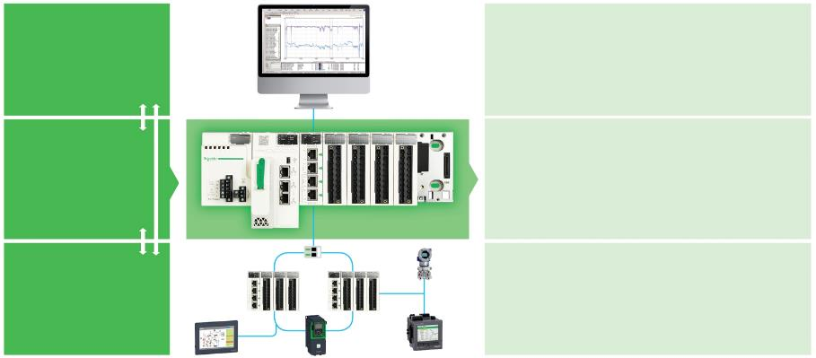
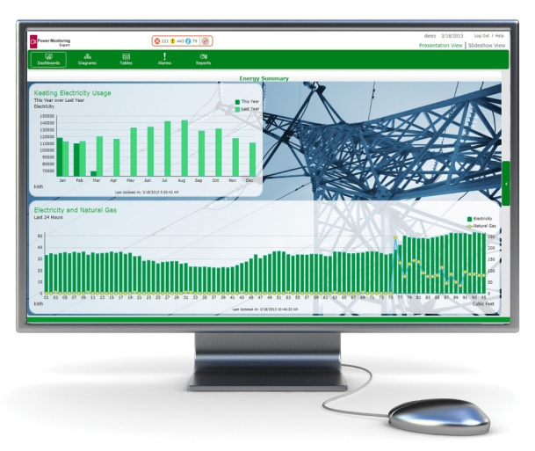
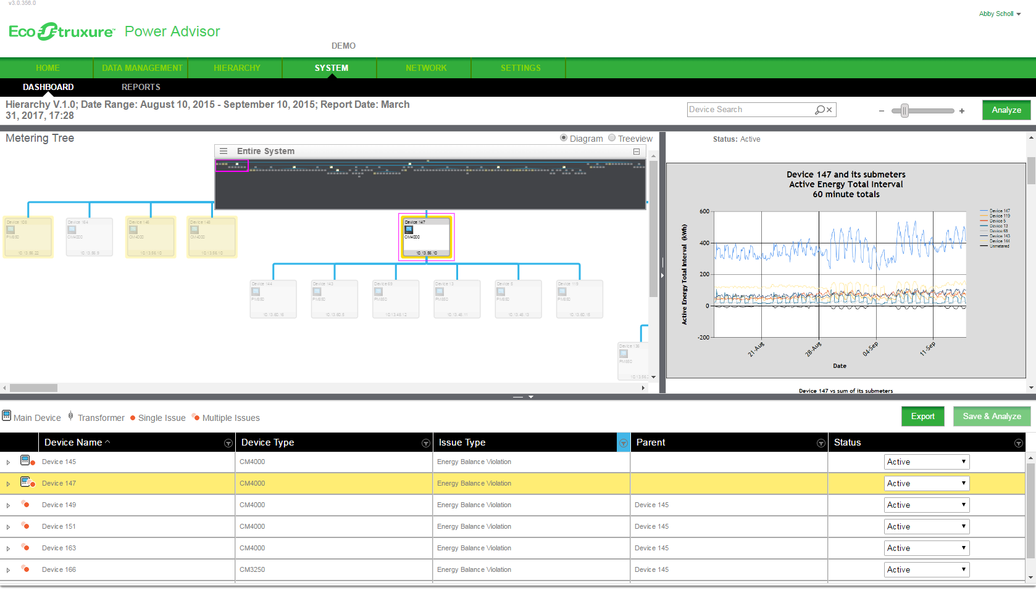
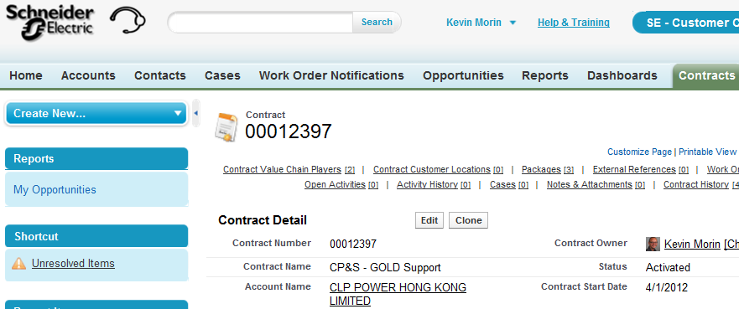


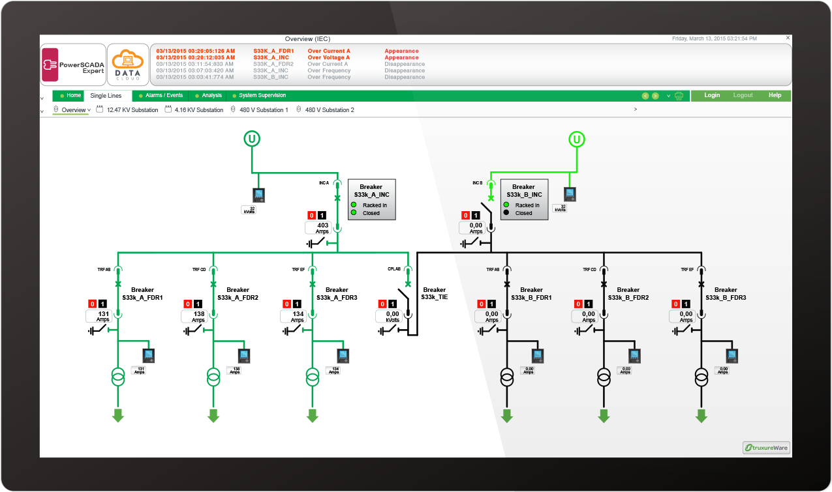

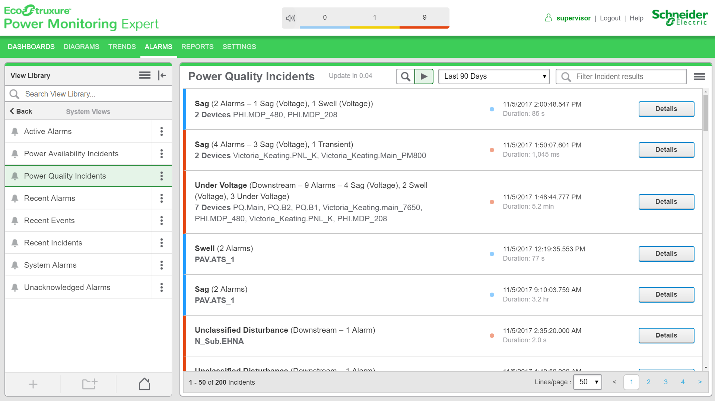
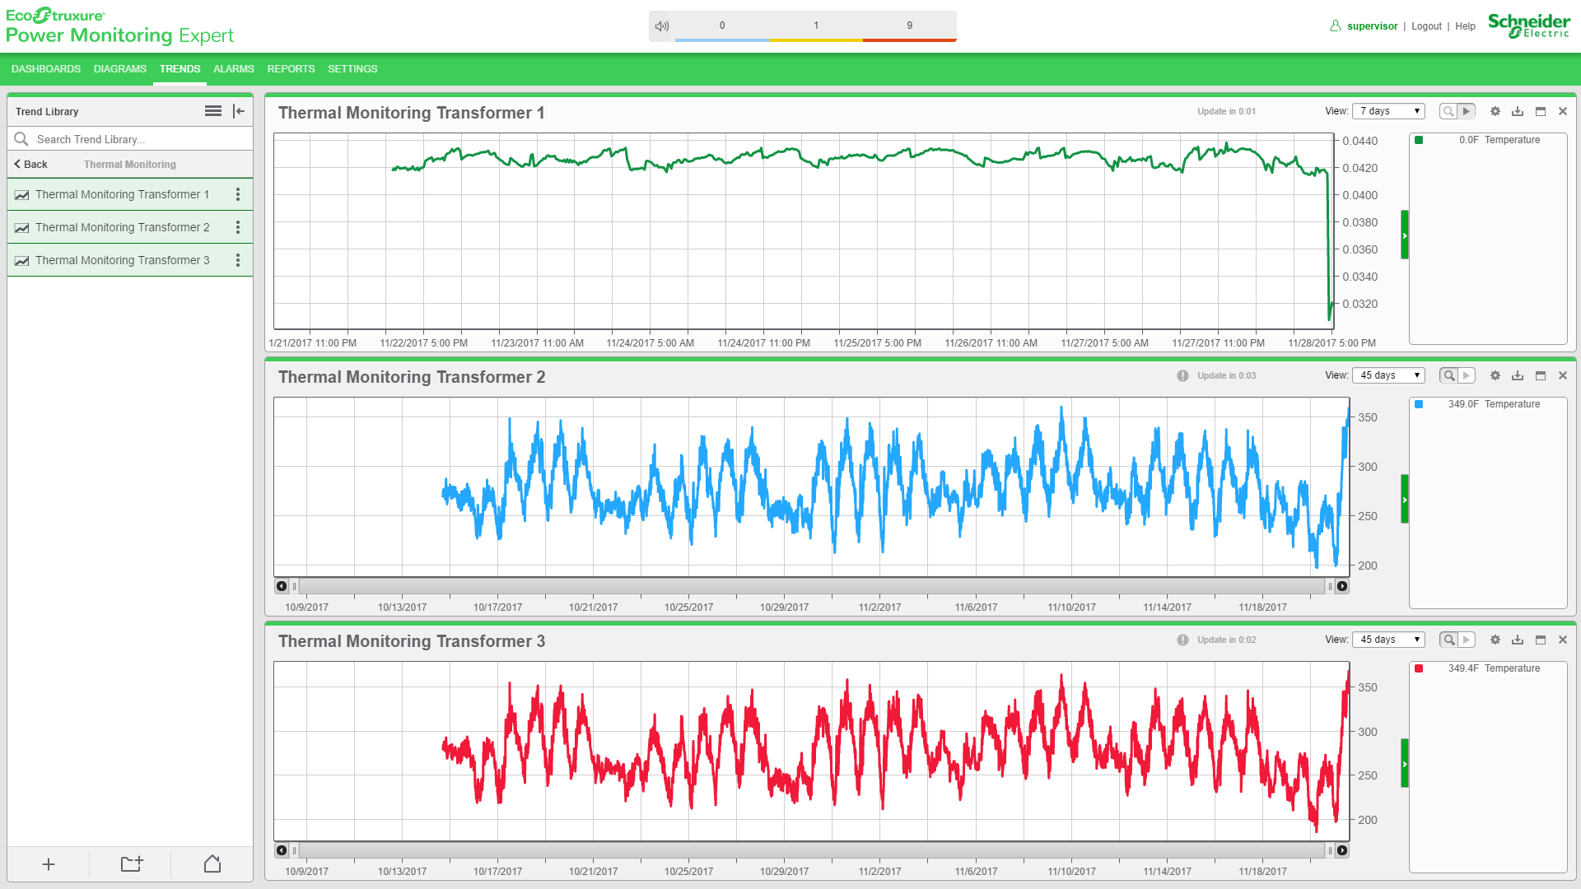

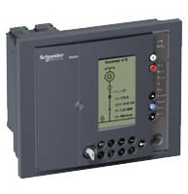
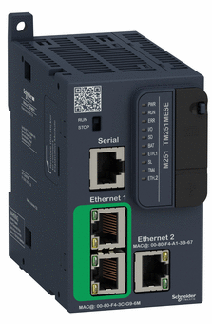
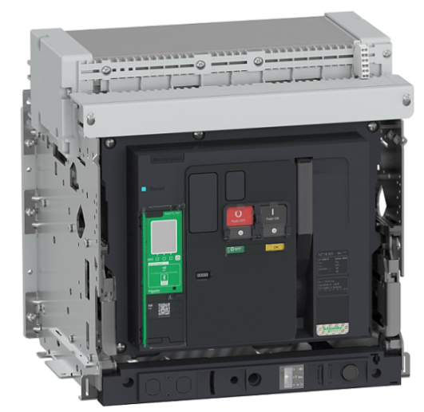
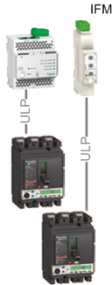
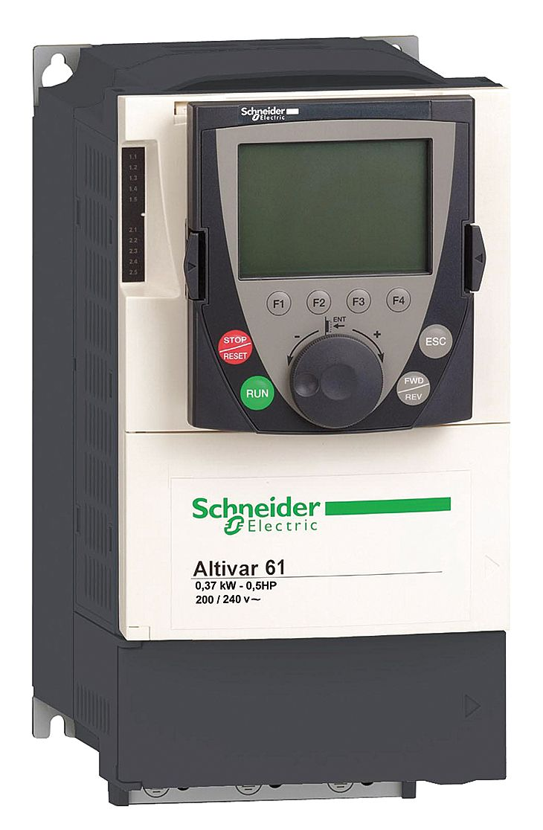
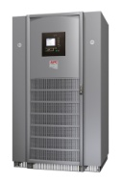
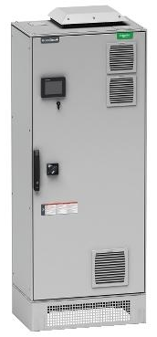
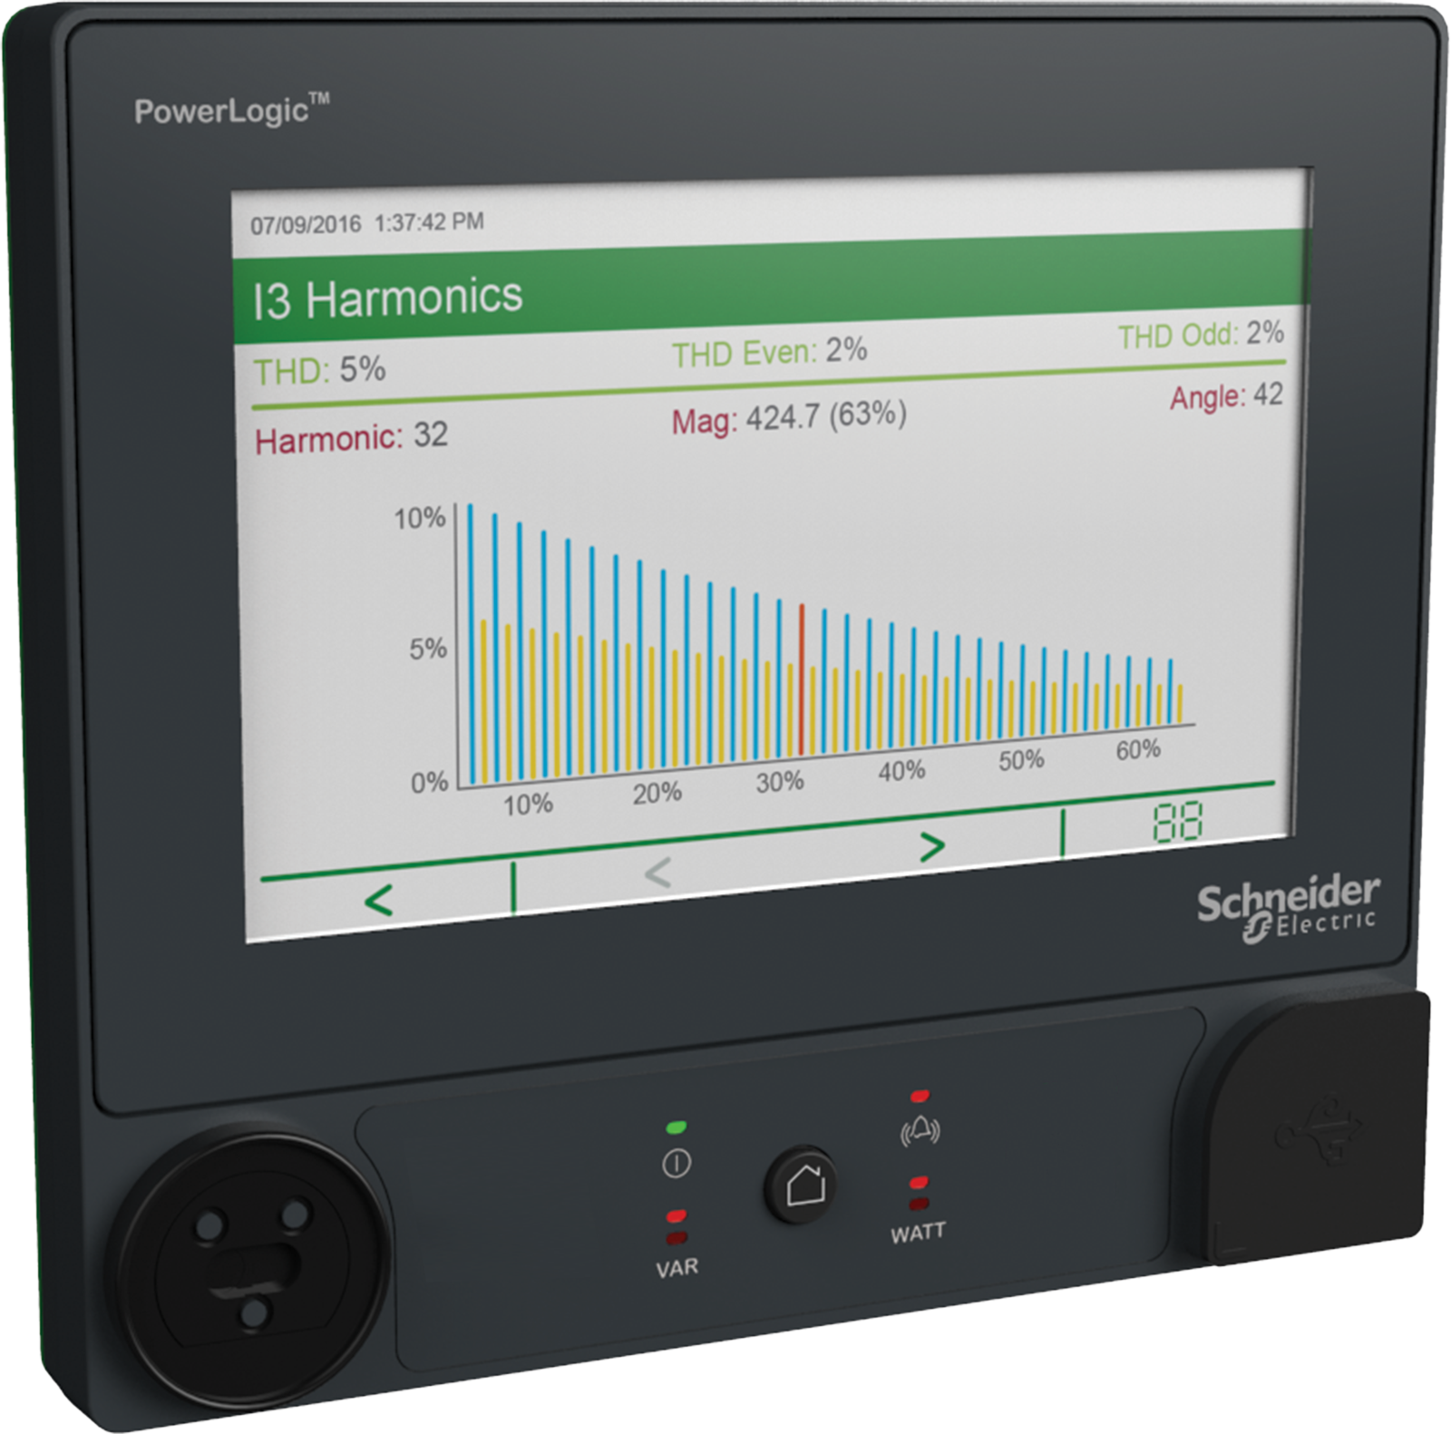

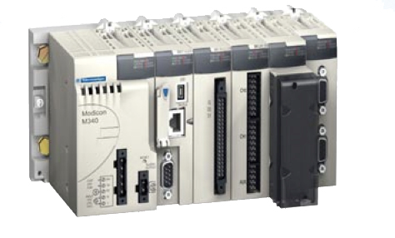


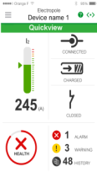
Modular Edge Control Platforms
EcoStruxure Power Applications Enabler
Protect People and Assets
Optimize Business continuity
Apps, Analytics & Services
Safe
Reliable
Power Advisor
PME/PSO
+
Energy Analysis
Modules
Edge Control
Maximize Lifecycle Efficiency
Simplify Regulatory Compliance
Efficient
Compliant
IP Communications Backbone
Connected Products
Power
Meters
Protective
Relays
RTUs,
PLCs
Breakers,
Trip
Units,
Gateways
FD
Breakers,
Sensors,
Gateways
Variable
Speed
Drives
UPSs
Water,
Air,
Gas,
Steam
PQ
Correction

Slide 7
Agenda
1
Intro
2
Energy Analysis Reports Details
3
Energy Analysis Dashboard Details
4
Design and Quote and Prerequisites
Notes:
Agenda slide

Slide 8

Power Monitoring
is a key component of a facility’s
Energy Management ecosystem
Energy Monitoring
Energy Cost Allocation
Energy Cost Management
Energy Performance
I would like to…
Collect information about how much energy is consumed and where. I want to baseline our usage.
Hold groups accountable for costs related to their energy use, and create general awareness on energy use in this facility.
Develop strategies & action plans to reduce energy or improve how we use energy, in order to reduce our operating costs.
Identifying Opportunities:
Managing energy costs.
ROI:
Reduction of energy related costs.
Energy is a cost driver in our business. Energy reduction strategies should be linked to key business indicators.

Slide 9
Understand Energy Usage in the Context of Operations
Improve Operational Efficiency and Energy Performance
Energy Analysis tools to easily:
Understand energy usage patterns and find energy waste
Analyze system capacity and capacity utilization as configurations change and loads are added
Isolate factors contributing most to energy usage and help target efficiency initiatives
Assess energy and power usage based on how equipment or processes are operating
Track energy performance indicators (EnPIs) such as Energy Intensity (kWh/unit), Coefficient of Performance (COP), Power Usage Effectiveness (PUE), in accordance to ISO50006
Evaluate energy usage in context of environmental factors or production
Create energy usage models and compare actual vs. expected
Track and report energy performance according to standards like ISO50001/50002, Superior Energy Performance and others.
Maximize Lifecycle Efficiency
Efficient
Simplify Regulatory Compliance
Compliant
Notes:
Why Track Energy Performance?
• Part of sound building operations
• Verify energy savings from projects
• Identify additional savings
• Make sure savings persist over time

Slide 10
Energy Analysis Modules Applications
Aligned with EcoStruxure Power
What it does?
What it brings?
Energy Usage Analysis
Analyze how much energy is consumed by the various load types and/or areas in your facility
Help determine where to focus your energy conservation initiatives
Compare the efficiency of energy use across buildings / plants / process lines and benchmark the good performers vs. the poor performers.
The good performers can be used as a model to improve the bad performers
Energy Benchmarking
Energy Efficiency Compliance
Provide an overview of water, gas, electricity, steam usage to staff, auditors, visitors and other stakeholders
Awareness drives conserving behavior (up to 10% reduction)
Energy Performance Analysis
Analyze the energy performance of your facility or building against a modeled baseline which takes into account relevant energy drivers
Provide feedback loop between energy managers and operations so that equipment and processes can be fine tuned to maximize the energy efficiency
Energy Performance Verification
Determine the difference between pre-retrofit and post-retrofit energy consumption while taking into account all relevant energy drivers such as outside temperature, occupancy or productivity
Track the improved performance, verify and report savings. Sustain the improved performance and associated savings, and find ways to further improve.

Slide 11
Energy Analysis Modules Details
Components of the two modules
Energy Analysis Reports Module:
Features Enabled (11 Reports):
  Modelling: Create and Use Model Reports
  KPI Engine Report
  KPI by TOU Report
  Energy and Power Usage by State Reports
  Single and Multi-Equipment Operation Reports
  Energy Regression Report
  Power Usage Effectiveness (PUE) Report
  Duration Curve Report
Energy Analysis Dashboard Module:
Features Enabled (6 Dashboard Gadgets):
  Sankey Diagram Gadget
  Heatmap/carpet plot Gadget
  Consumption Ranking and Aggregated Ranking gadgets
  Pareto and Aggregated chart gadget

Slide 12

Energy Analysis Reports Module

Slide 13
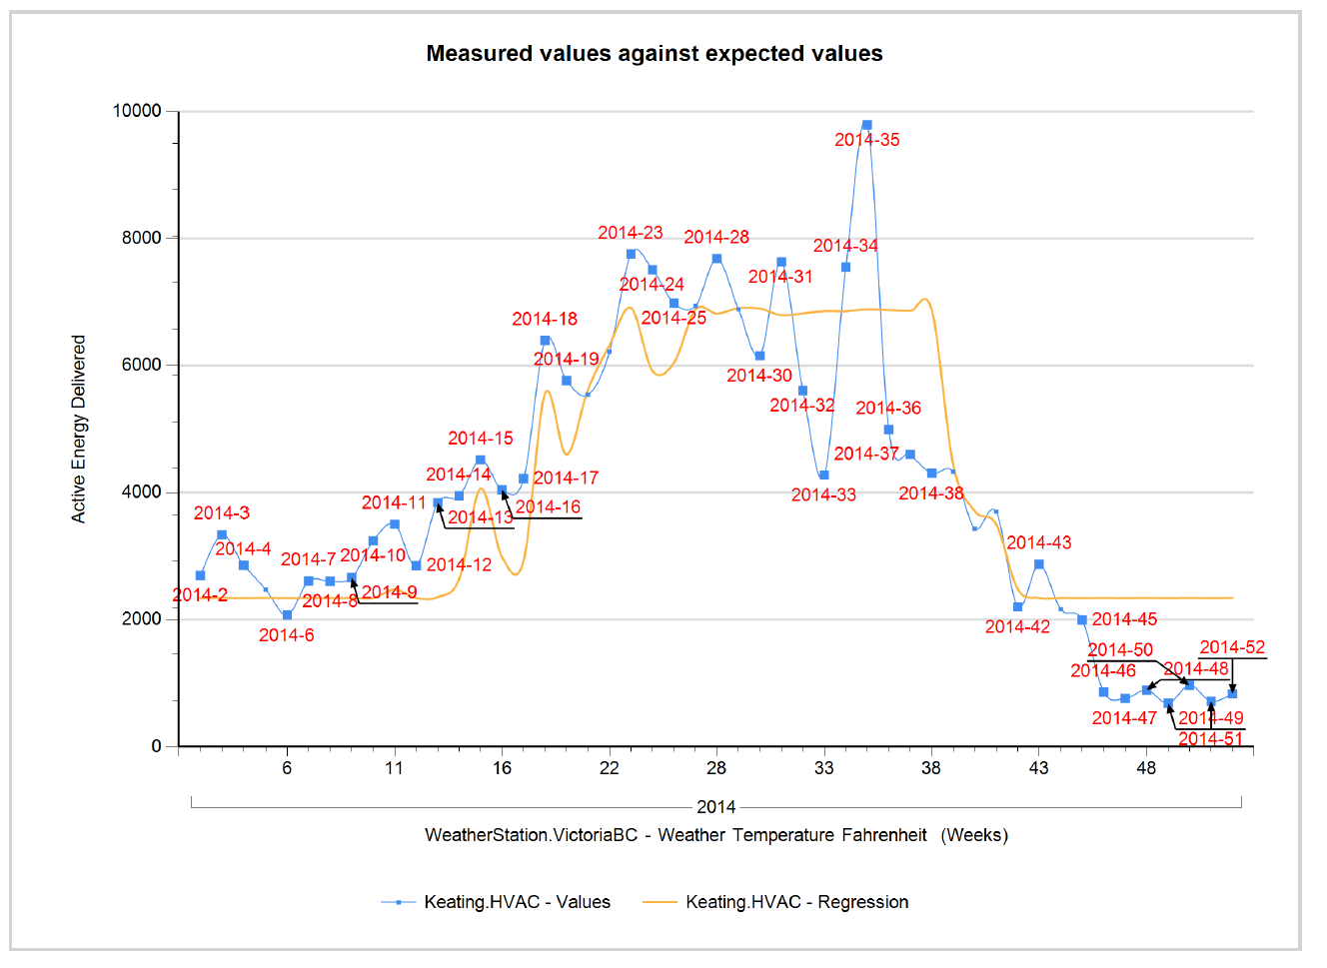
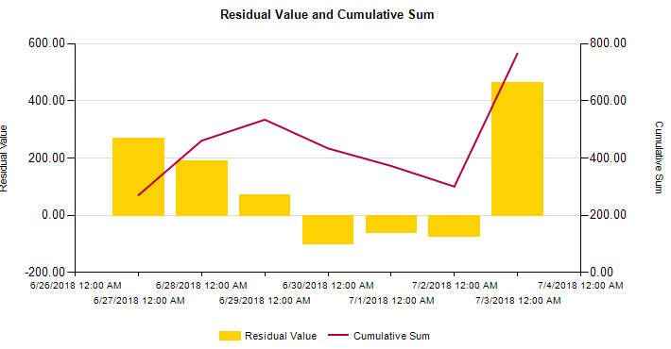
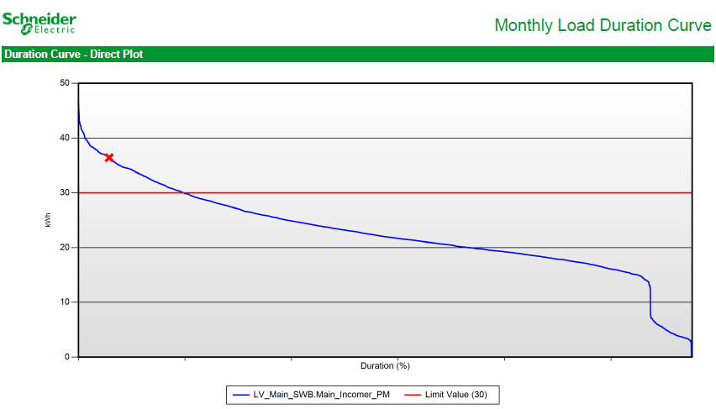
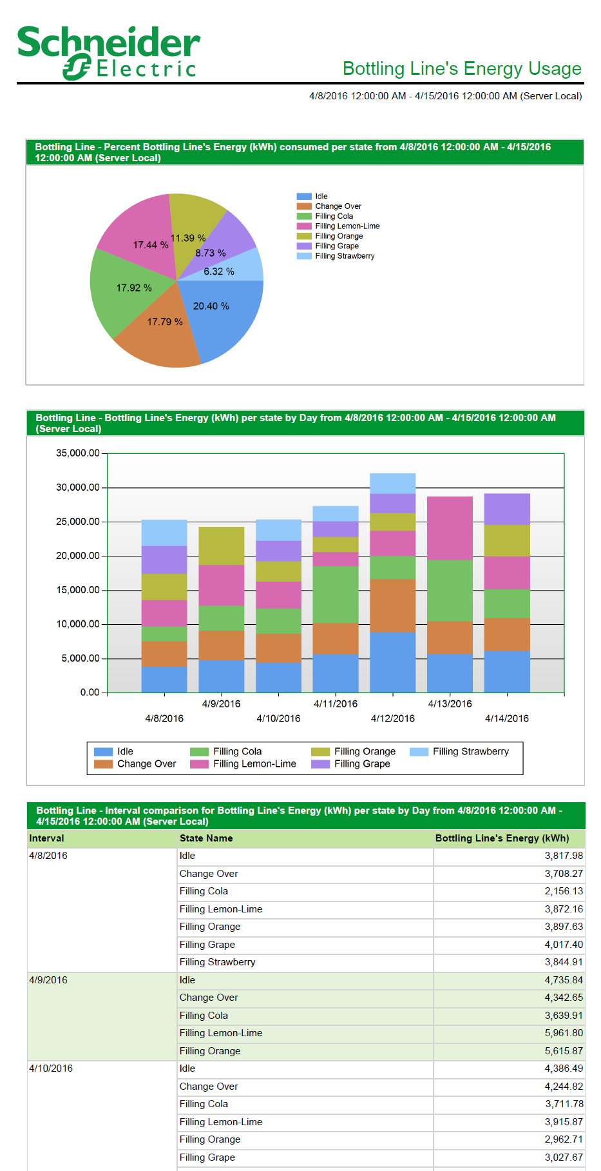
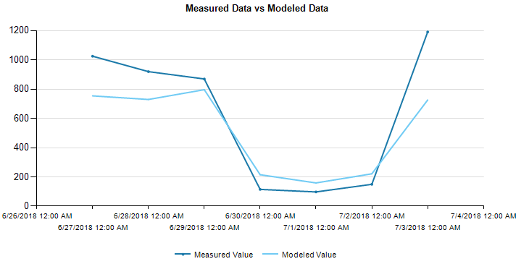
Applications and Features
Energy Performance Analysis and Verification:
  Modelling Reports
2. Energy Usage and Performance Analysis based on operational data:
  Energy Regression
  KPI Engine Report
  KPI by TOU Report
  Energy and Power Usage by State Reports
  Single and Multi-Equipment Operation Reports
  PUE Report
3. Capacity Usage and Analysis:
  Duration Curve Report

Slide 14
1. Energy Performance Analysis and Verification
Tools for Energy Modelling

Slide 15
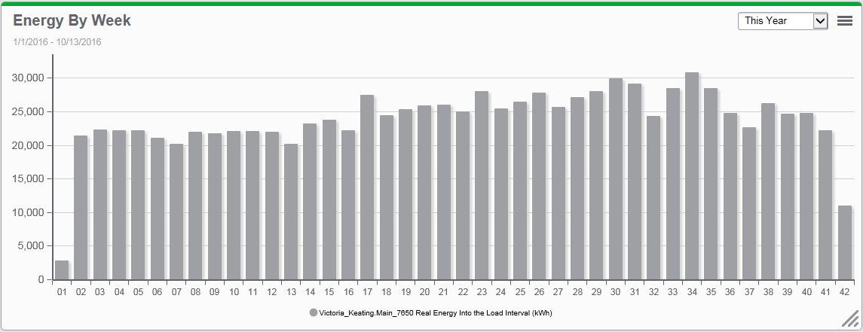
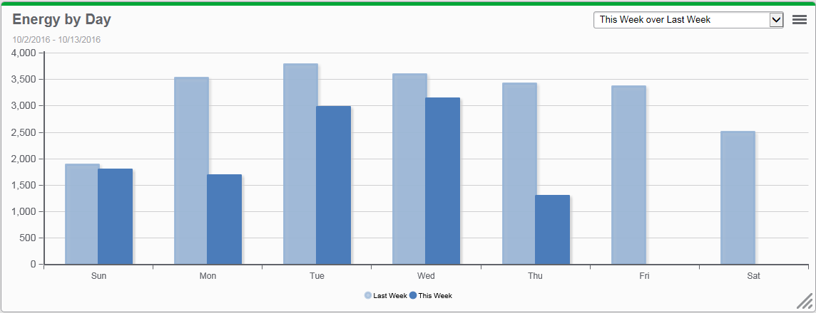
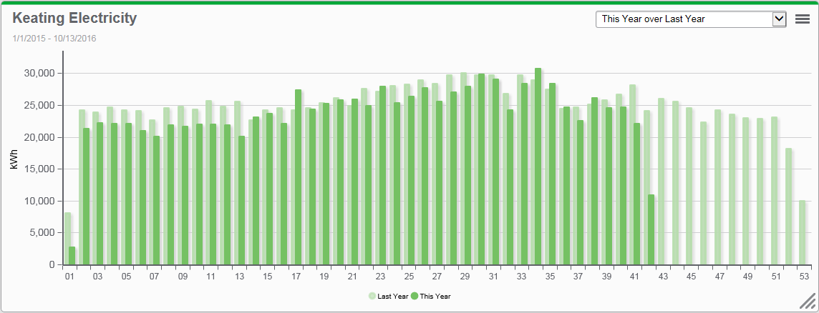
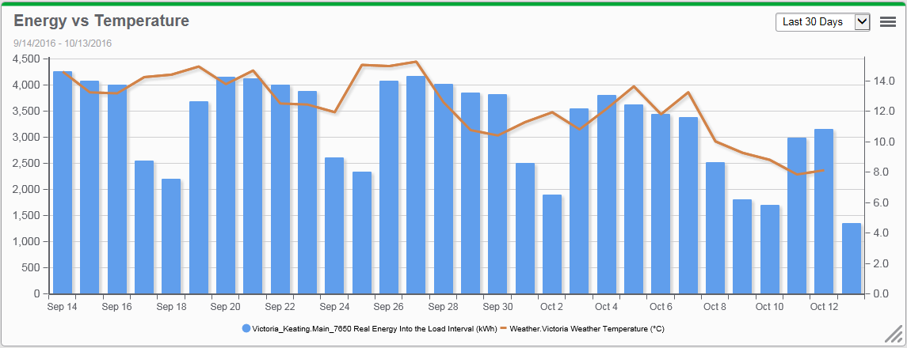
Energy Modelling
Why do we Need an Energy Model?
Analyzing raw data can be tricky
There is no way to know for sure if the value we read is meaningful or not
Exceptions get forgotten and will not make sense a few months after the fact (e.g. Holiday Monday)
Visually interlacing influencing factors is hard and inconclusive
Notes:
1st Graphic : Based on this view, can you tell me how my energy usage is doing ? Am I good ? Am I saving money or spending too much of it ? There is no way to tell.
2nd/3rd Graphic : Some people will use a Period Comparison to compare energy use. But is that really useful ? Are all the period conditions identical ? Not Really.
4th Graphic : Then, lets plot one of the most well known energy influencers in the Building segment on top – Temperature. Does that help ? A little bit, but this is not perfect either.

Slide 16


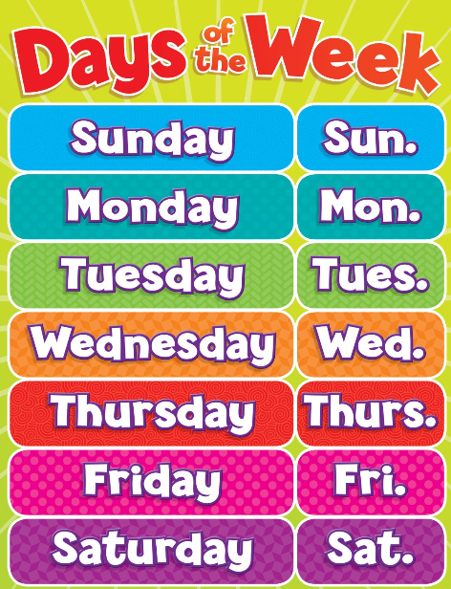







What Factors Influence Energy Usage?
Weather (e.g. Outside temperature)
Production volumes (# of units, tons, etc)
Hours of Operation and operation schedules (work hours, weekdays vs weekends, seasons, shifts, etc)
Base loads
Building occupancy
Notes:
Question: What things can influence your facilities energy use?
(ask audience, gather responses)
All of these (and more) can influence my Energy usage. They all participate in different ways. Some directly, some indirectly.

Slide 17
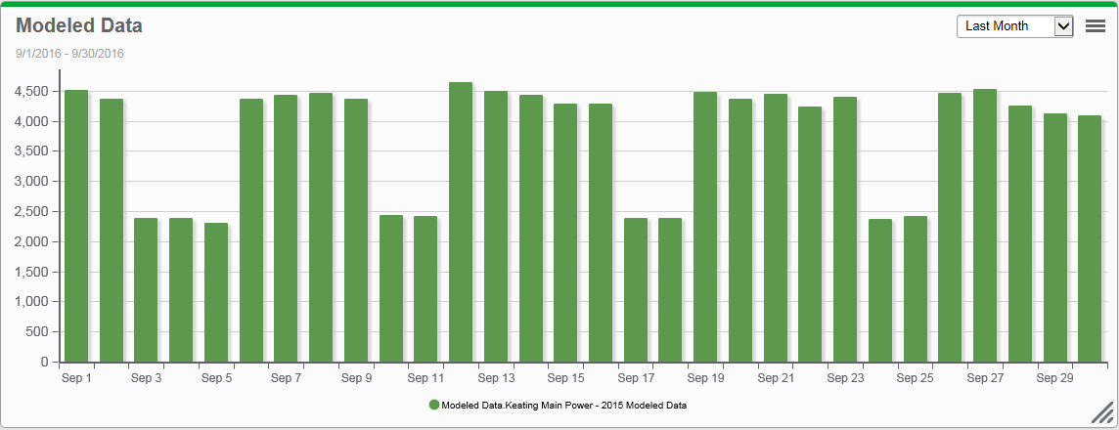
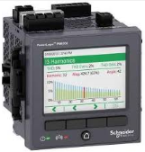
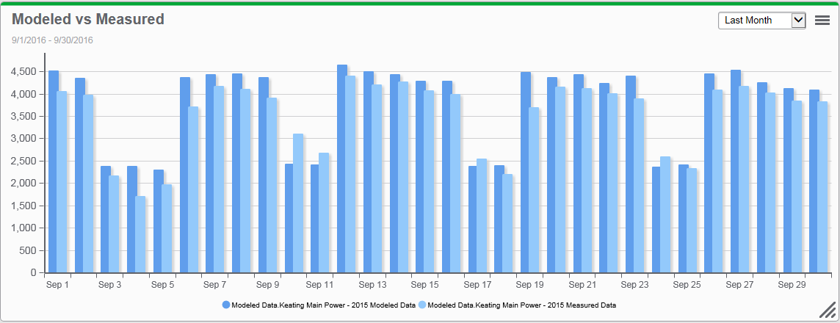
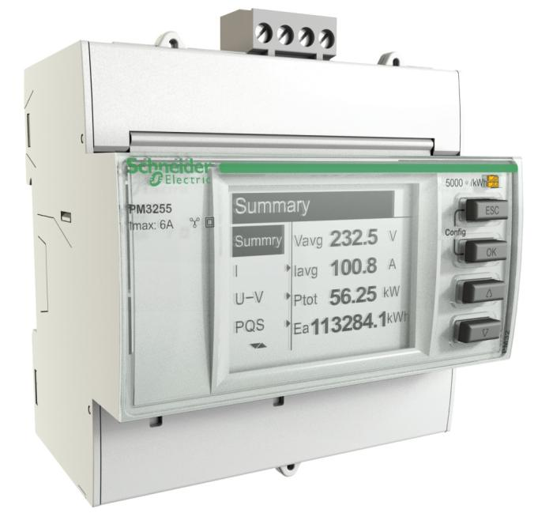
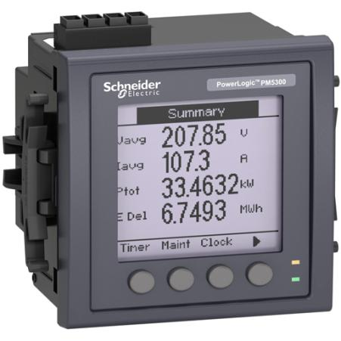
How is an Energy Model Created?
2. Historical data for influencing factors
3. Scheduling
1. Historical data for energy usage (including base loads)
4. Track actual usage vs expected values from model
Notes:
Influencing factors can be classified into 3 categories:
Base Loads that are running most of the time or on fixed schedule.
Influencing factors that impact some of the loads like Production Volume and Weather
Scheduling which influences how base loads and influencing factors are used
Based on these 3 categories, we are able to use a statistical approach and create a Model of our Energy use. That model is able to calculate how much energy should be use in any condition. That will allow us to compare the “ideal” or modeled Energy usage to the “Measured” or actual Energy usage to draw conclusions.

Slide 18
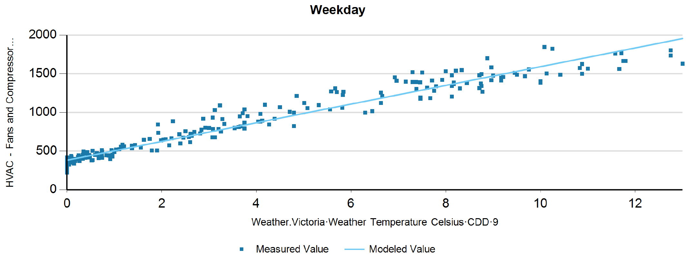
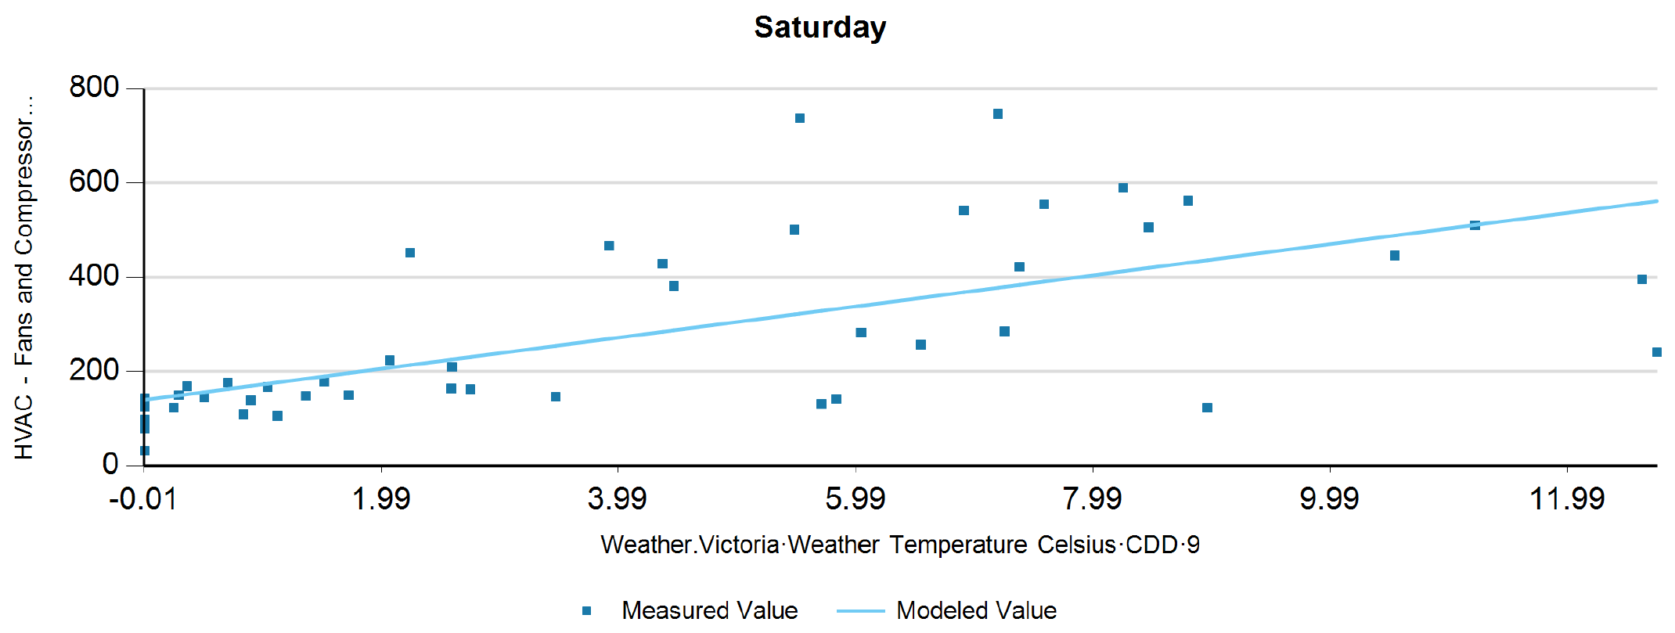
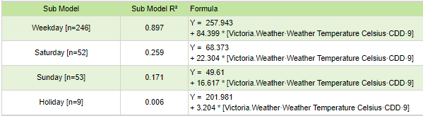
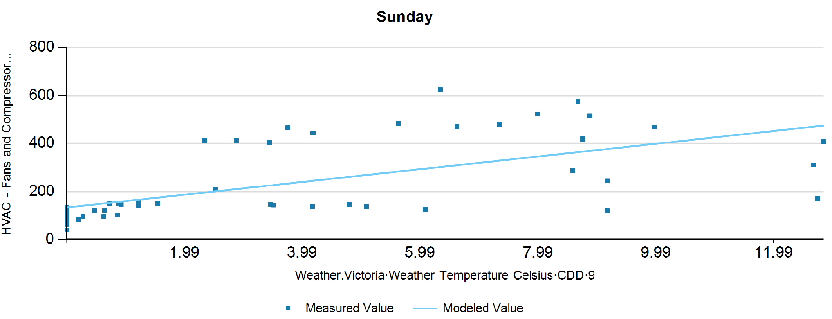
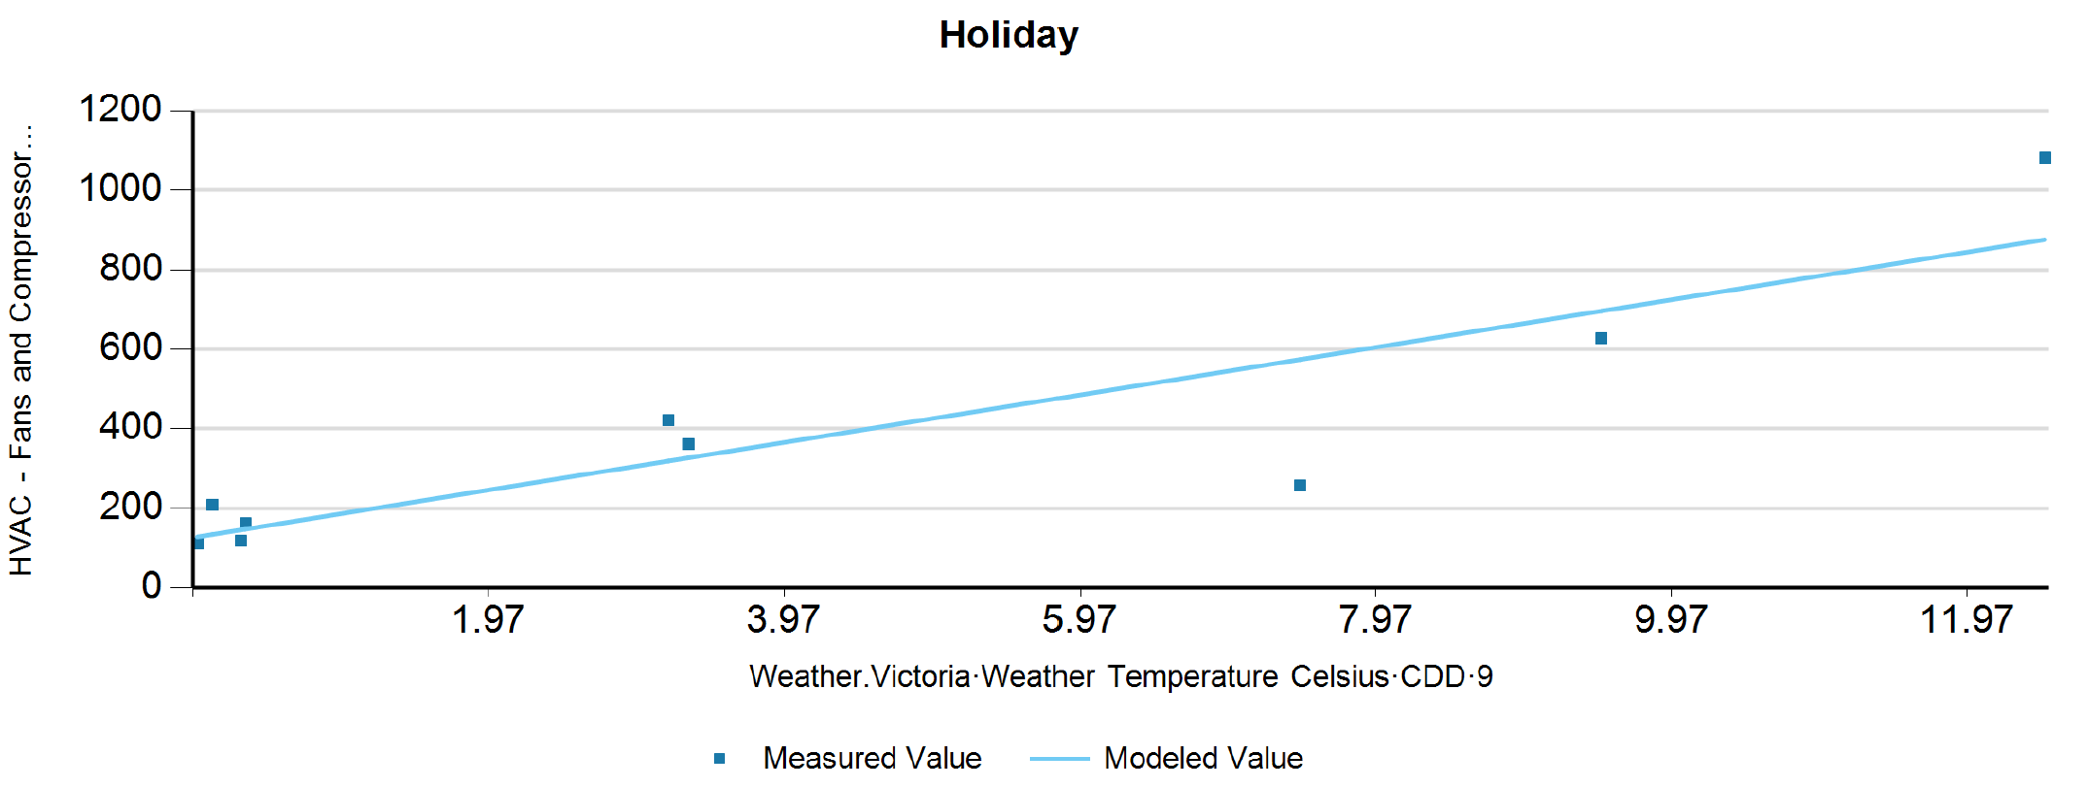
How is an Energy Model Created? (cont.)
Let’s consider just 1 influencing factor (outside temperature)
Energy vs Temp relationship can be represented by a line (y = ax + b) as seen in the scattered plot
Energy = a*Temperature + b
Great ! But, is not that simple…What about the scheduling influence?
Is the energy vs temperature the same every time?
In this case we have 4 sub-models, to represent the energy vs temperature relationship. The system takes care of all the statistical analysis, the user just needs to tweak the parameters and select the best model.

Slide 19
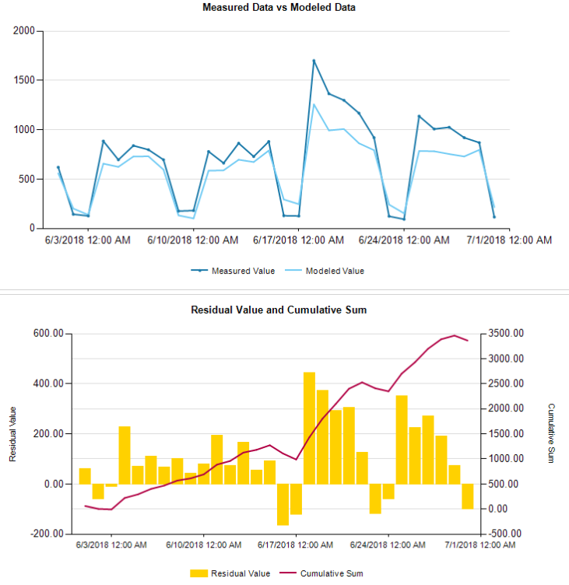
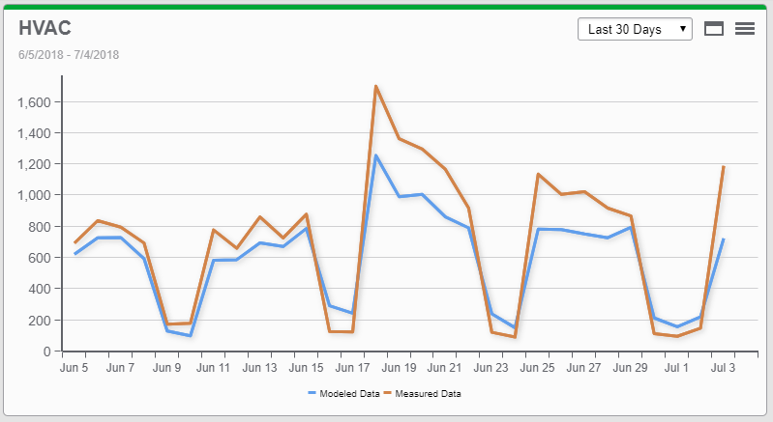
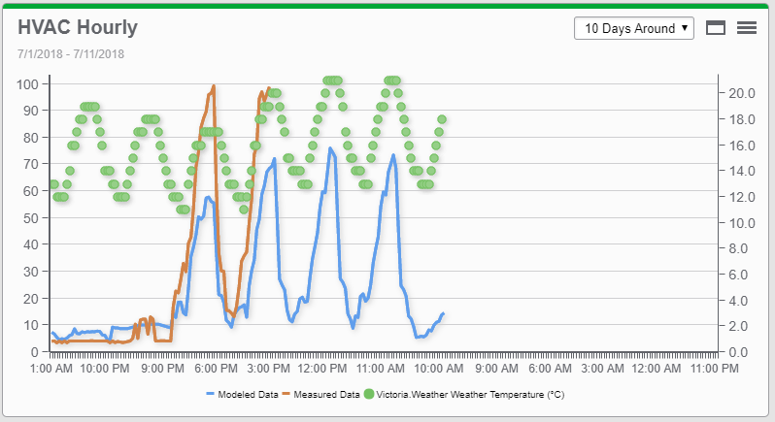
I have an Energy Model, Now What?
The fun begins
Quantify real savings or losses
Forecast Energy Usage
Track energy performance against baseline
Get notified if usage is outside expected values
Energy Analysis Modelling Engine
Models are stored
in database

Slide 20
Modelling Engine Technical Details
Energy Modeling feature set includes:
Multi-Variable Linear Regression Engine
Supports Sub-Models to use different models for different TOU or uses a Database driven approach
Allows different regression and reporting aggregation intervals
Exception Period Table to “Discard” Period(s) or assign specific data to different a Sub-Model
Fully customizable Sub-Model and Exception Periods via web configuration tool
Measured VS Modeled Graphics as well as Residual and Cumulative Sum graphics
May insert result back to Database for further use in Dashboard, Reports, Trends, VIP
Hierarchy Support for the dependent variable
Ability to insert “Saving Coefficients” when using the Model to verify savings or set objectives

Slide 21
2. Energy Usage and Performance Based on Operational Data
Energy Drivers, Performance Indicators and Operation Optimization

Slide 22
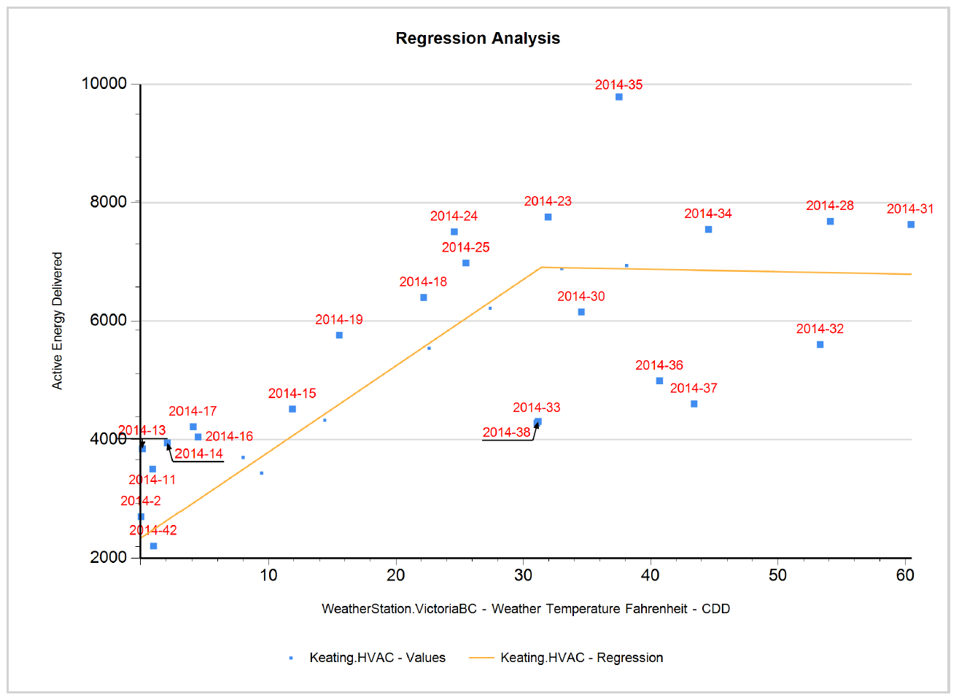
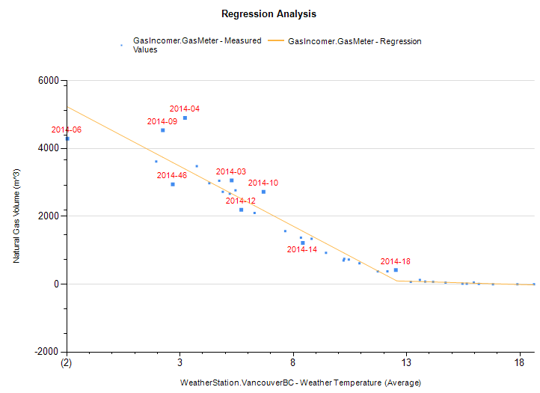
Energy Regression Report
This report shows the relationship between two variables to:
  Check correlation between variables for example energy usage to drivers such as production, weather or any other.
  Quickly identify drifts from expectations and identify outliers.
Any variables stored in the database can be used in the report.
Note: The modelling reports include same functionality

Slide 23
How To Use the Report?
Case 1 – Use outliers to quickly identify anomalies
What occurred on weeks where the Energy use is higher than expected ?
Did somebody changed a set point ?
Did a technician forgot a damper in forced open mode ?
Was a large door left opened ?
Is the motor suddenly failing ?
Production Machine under performing
Outlier
Detect! and solve the issue

Slide 24
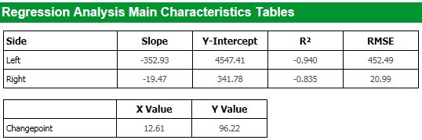
How To Use the Report?
Case 2 – Work on Regression Slopes
The slope of the regression line represent how much the driver influence the model.
In this case, it represents how many additional kWh the HVAC unit would use each week for each additional averaged Degree Celsius : -352 kWh / °C avg
Obviously, being able to monitor that value trough time enable the user to see if the building energy performance is degrading or improving.
BAD : The Heating System Kicks in too early
GOOD : The Heating System Kicks in much later

Slide 25
How To Use the Report?
Case 3 – Work on Regression Break Point
  The break point represents how soon (cold) an HVAC unit will kick in
  In the above case, it informs the user that as soon as the avg weekly temperature is below 12.6 °C, the HVAC unit will start heating.
  Obviously, being able to monitor that value trough time enable the user to see if it’s building is degrading or improving.
BAD : The Heating System Kicks in too early
GOOD : The avg temperature has less influence over the Heating system

Slide 26
Energy Regression Report Details
Features enable the user to
Scatter plot anything against anything
Aggregate the data per day or per week
X-Axis Aggregation methods : Avg, Sum, Delta, HDD, CDD
Y-Axis Aggregation methods : Avg, Sum, Delta
Calculate the correlation between the X and Y axis and express it as a single line or broken line formula
Draw the best fitting line(s) on top of the scatter plot
Ordered by X-Axis Driver
Ordered by Time
Add simple data quality checks to remove days or week with incomplete dataset
Report unexpected days or weeks ( too far away from expected value )

Slide 27
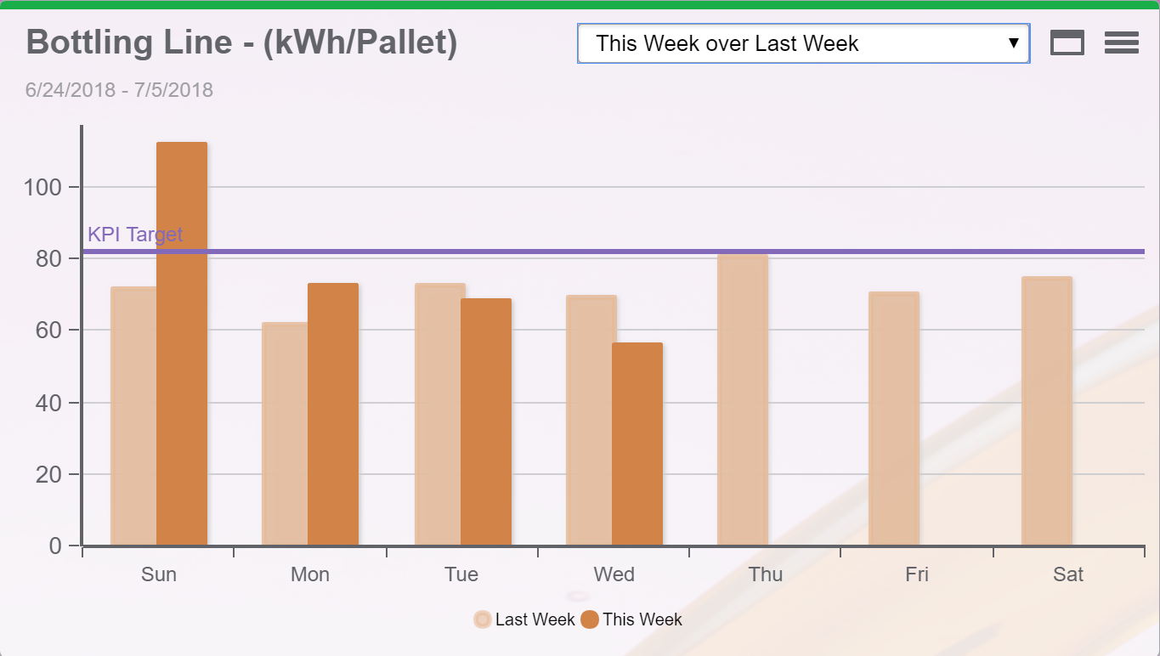
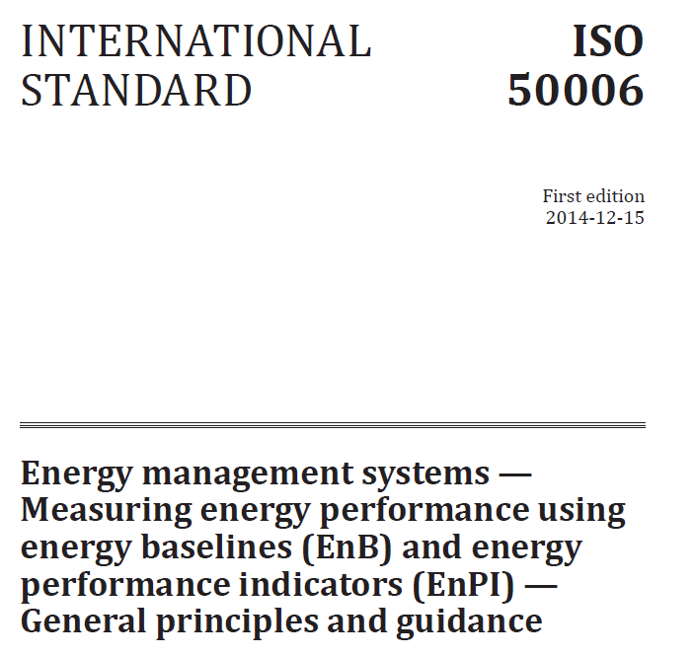
KPI Engine
Create Energy Performance Indicators
Energy and power monitoring data is more valuable when “contextualized” with operational data. For example:
Energy per product is easy to understand for management because it ties back into the high-level cost per product that they track for profitability.
This EnPI helps establish energy improvement CapEx, as a dollar amount saved per product, which allows comparisons against other cost reduction measures.
EnPIs allow comparison against the energy efficiency of other products within the same facility, against the energy performance of an existing facility and, even against the energy performance of a competitor’s facility or a competing production technology.
Notes:
KPI: Key Performance Indicator
EnPI: Energy Performance Indicators
ISO 50006:2014: Measuring energy performance using energy baselines (EnB) and energy performance indicators (EnPI)

Slide 28


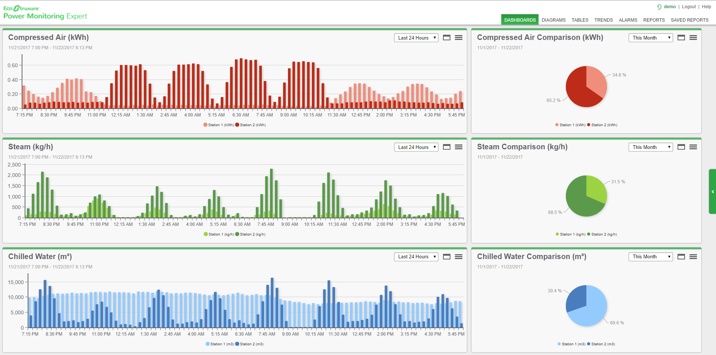


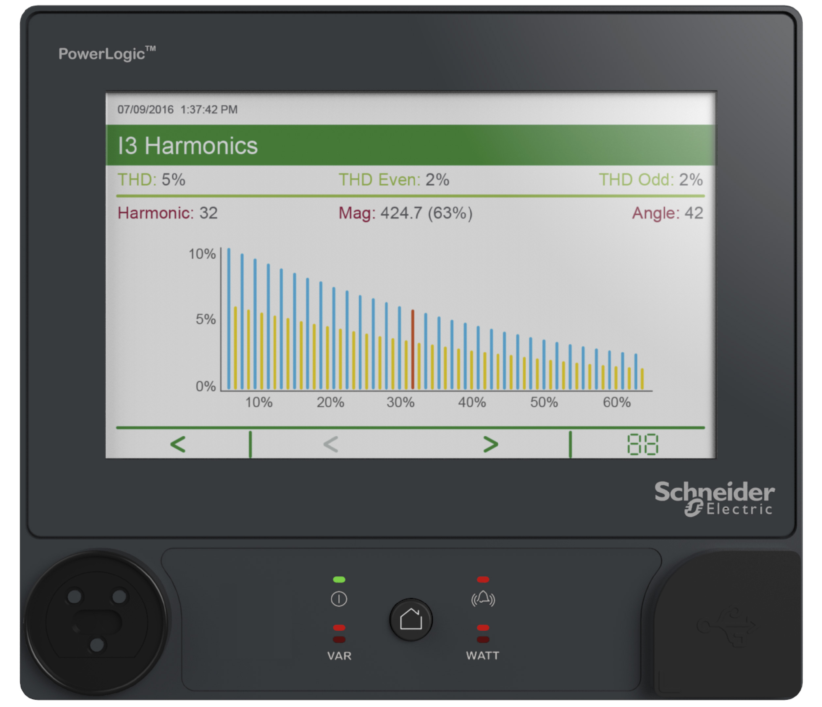
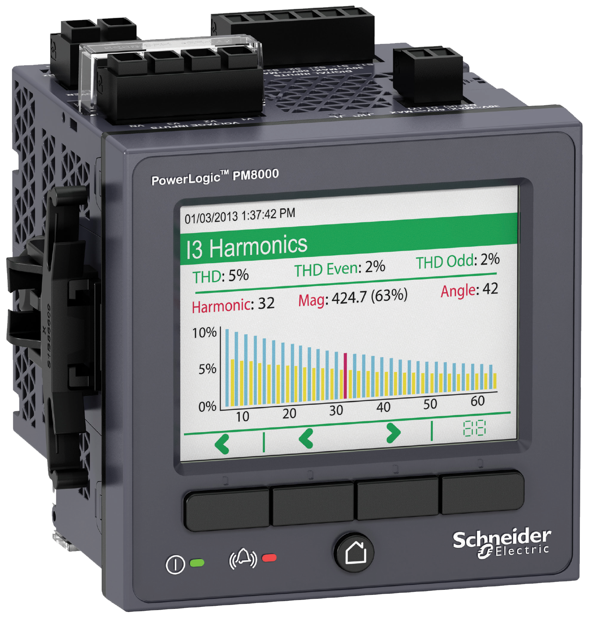
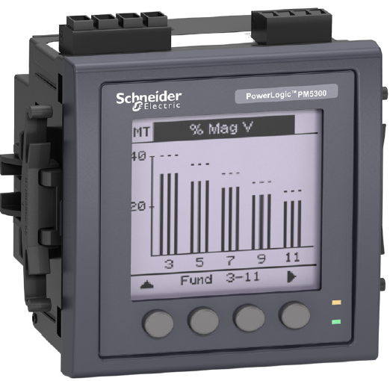
KPI Engine (Cont.)
Process Data
Energy Analysis KPI Engine
KPI examples:
Production kWh / kg, €/ kg, kWh/Ton, kWh/Unit
Carbon footprint: kg of CO2 / Ton, kg of CO2 / m3
Pumps efficiency: kWh / m3 of water pumped
Blowers efficiency: kWh / kNm3 of air forced
3rd party
Energy/WAGES Data

Slide 29
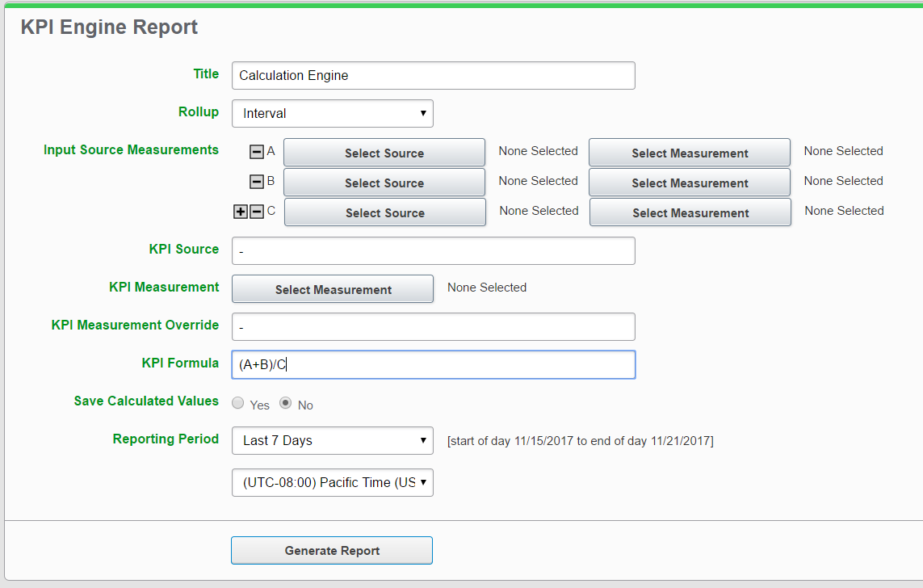
KPI Engine Report
Simple web based engine to create relevant business EnPIs or KPIs based on any logged or imported PME data.
Combine multiple measurements from different sources to create business relevant KPI's
Automatic Source/Measurement creation as required
Preview and complete back fill support as far as logged data exists
Steady State KPI calculation via normal report scheduling
Support for Interval, Hourly, Daily, Weekly, Yearly KPI calculations
Extensive expression support: primary, power, multiplicative & additive operator support
  (A+B)/C, A+B+C, C/(A+B), Pow(A+B+C+2), sqrt(A+B), etc

Slide 30

KPI Engine Report (Cont.)

Slide 31

KPI by TOU Report
This report can normalize source measurement pairs and apply a scale factor from another source measurement pair. It also supports different rollup periods and TOU, and can email notification on target value exceptions. Being one of the most flexible reports, this report gives you different options to analyze energy usage and stay alerted on abnormality

Slide 32

KPI by TOU Report (Cont.)
Support of hierarchy sources
Normalize kWh into common consumption among sites, production lines, processes and so on to get overall summary of consumption

Slide 33



KPI by TOU Report (Cont.)
Use a scale source and measurement and scale multiple to calculate simple KPI such as
kWh/person = kWh / occupancy count * 10, where occupancy count is the scale source measurement pair and 10 is the scale multiplier

Slide 34




KPI by TOU Report (Cont.)
Use Standard deviation as targets to visualize consumption and to send out notification when there is target value exception so that you can make adjustment or preventive measures to manage energy consumption

Slide 35


PUE Report
Datacenter Specific KPI/EnPI
Power usage effectiveness (PUE) is a metric used to determine the energy efficiency of a data center.
  PUE is determined by dividing the amount of power entering a data center by the power used to run the computer infrastructure with in it.
  Report is generally applied for level 1 and 2 PUE Measurement. The difference is based on where the IT Load is measured.
  Categories are based on the Green Grid’s standard for measuring PUE

Slide 36

PUE Report (Cont.)
Summary Table Displays 24 Hour, 7 Day, 30 Day, and Last 12 Month PUE Averages
Trend Displays Per Week Roll Up PUE Value for a Full Year
Stacked Bar Graph Displays IT Load in Green and Support Load in Blue

Slide 37
Energy Usage by State
Analyze energy usage according to operational mode or status of processes, systems or equipment:
  Baseline energy usage throughout the process lifecycle
  Understand which products use the most energy to make
  Determine if a process is using excessive or unexpected energy
  Reduce energy usage without compromising production
Analyze Energy Usage by Process States
  Idle
  Change Over
  Cola
  Lemon-Lime
  Orange
  Grape
  Strawberry
EXAMPLE:
Bottling Plant

Slide 38

Power Usage by State
Power usage can be tracked by operational mode
or status of processes, systems or equipment:
Adjust operations and processes to lower peak demand
Detect power anomalies and optimize equipment operation
Analyze Power Usage by Process States
  Idle
  Cola 500ml
  Lemon-Lime 500ml
  Orange 500ml
  Grape 500ml
  Strawberry 500ml
EXAMPLE:
Bottling Plant
  Cola 2L
  Lemon-Lime 2L
  Orange 2L
  Grape 2L
  Strawberry 2L

Slide 39


Operational Status Reporting
Analyze how equipment is operating to find anomalies and correct problems
  Hours of operation in each state/mode
  % hours in each state/mode
  Number of activations in each state/mode
  Average activation duration

Slide 40


Operational Status Reporting
Analyze how systems operating to find anomalies and correct problems
  Hours of operation in each state/mode
  % hours in each state/mode
  Number of activations in each state/mode
  Average activation duration
EXAMPLE: Water Pumping System
Analyze System Operation
  Off
  Low Speed
  Medium Speed
  High Speed

Slide 41
3. Capacity Usage and Analysis
Demand and Loading Analysis

Slide 42
System and load Capacity Analysis
Statistical analysis for
  Reducing peak demand or lowering
  base load
  Validating performance characteristics
  Transformer capacity modelling
Duration Curve Direct Plot
  Configurable limit value for overlay in chart and act as a filter in the data table
  Selectable % crossing indicator in
  the chart

Slide 43
System and load Capacity Analysis (Cont.)
Statistical analysis for
  Reducing peak demand or lowering
  base load
  Validating performance characteristics
  Transformer capacity modelling
Duration Curve Direct Plot
  Configurable limit value for overlay in chart and act as a filter in the data table
  Selectable % crossing indicator in
  the chart

Slide 44

Energy Analysis Dashboard Module

Slide 45




Energy Analysis Dashboard Module
Easy to setup Energy Analysis Tools based on Dashboards

Slide 46



Consumption Ranking & Aggregated Consumption Ranking
Build energy awareness through normalization and ranking – easy to read and understand
Create a competitive environment with dynamic rankings
Normalization to facilitate fairer comparisons
Relative visualization
One-click export to excel

Slide 47



Pareto & Aggregated Pareto
The Pareto principle is also known as the 80–20 rule, quickly see where your biggest issues are
Roughly 80% of the effects come from 20% of the causes
Develop timely solutions to energy management/performance
Powerful method of assessing your facility
One-click export to excel

Slide 48

Heat Map/Carpet Plot
Intuitive graphical visualization of your energy use
Quickly and easily identify anomalies
Optionally exclude data gaps and spikes/outliers to focus on the true trends
One-click export to excel

Slide 49

Sankey Diagram
Clearly visualize energy flows, distribution, and losses
Automatically generated from hierarchies
Meet ISO 50001, ISO 50002 and ISO 50006 requirements, full WAGES support
Interactive gadget - hover over, move nodes, one-click export to excel

Slide 50

Contextual Data Integration

Slide 51

What is ETL?
ETL is a flexible data import/export tool for PME/PSO
It is most often used to bring operational context data into the PME database, or to share data from PME database with other systems.
It has a library of technologies that it can connect, to make configuration easier.
Source
PME
Target
ETL can be used to IMPORT historical data directly INTO the PME database
ETL can be used to EXPORT historical data directly FROM the PME database
ETL can also be used without PME to transfer data between other systems.

Slide 52







ETL Data Integration
Open and Interoperable
PME ETL (v4.11)
Import into PME from:
SQL or OLEDB database
CSV file
XML file / metadata file
Wonderware Historian
EGX300
Another PME system
Export from PME to:
CSV file
HTML file
Another PME system
ETL
3rd party

Slide 53


OPC Data Integration
Power Monitoring Expert has an OPC Server and OPC Client
Enables interaction between other Schneider Electric and 3rd party systems
Industry-standard real-time data interface (OPC DA 2.05a)
Power Monitoring Expert
OPC Server
OPC Server
OPC Client
Power Monitoring Expert
Wonderware
OSIsoft
kepware
Web Applications
Dashboards, Diagrams, Tables, Trends, Alarms, Reports
Notes:
53
Tip: Use OPC Tunneller when communicating between networked computers. It does away with the headaches typically associated with DCOM configuration

Slide 54

OPC Client
The OPC client mapping must be manually defined by the engineer using the Modbus Device Importer and other tools.
Once configured, the OPC client will read tags from other OPC servers in the system.
Industry:
Lots of PLCs
Wonderware
Profibus
…
Buildings:
Lonworks
BACNet
Data Centers
SNMP
Utilities
DNP 3.0
IEC60870-5-101/105
Survalent
NOTE: Device licenses and custom engineering is required for OPC Client functionality.

Slide 55



Manual Data Entry

Slide 56
Appendix A
Energy Modelling Deep Dive

Slide 57
Energy Modelling in PME
What is a model in PME?
  A mathematical formula that computes an estimated value of one source/measurement pair (like Energy from my main meter) from one or more others (temp, production, etc).
Where do they come from?
  PME creates a model under your control by examining the relationship between data in a body of reference (historical) data.
What are models used for?
  to set a ‘baseline’ behaviour for evaluating energy saving efforts
  to understand the influence of one thing on another
  to predict future values of consumption based on estimates of drivers

Slide 58
Creating a Model
The process of creating the
arithmetic function that best
represents the relationship between what you want to model (usually energy) and your influencing factors

Slide 59
Using a Model
Passing actual measured values from the influencing factors to the function to calculate an estimate of the variable of interest (usually Energy)

Slide 60
Beware the Buzzword!
The meaning of a buzzword is NOT always the same in PME and the Industry.
Buzzword | Meaning in Industry | Meaning in PME
Forecasting | Predicting future values based on present data | Estimating future values of a modeled quantity (usually energy) based on externally supplied predictions of model drivers (e.g. outside temp)
Baselining | Comparing current performance to a historical metric | Using historical data or model with specific behaviour for comparison against behaviour today
Digital Twin | “a dynamic virtual representation of a physical object or system across its lifecycle, using real-time data to enable understanding, learning and reasoning” | Multivariate linear regression functions

Slide 61
Models with Linear Relationships
There are many ways to model a relationship between 2 or more sets of data
  A model will outline a relationship between different sets of data
The PME modelling engine is only concerned with linear relationships (and piecewise linear) between variables, i.e.
  How does the production process affect our energy consumption?

Slide 62


Ah Yes, Linear Regression!
PME applies linear regression in the modelling engine
What is Linear Regression?
  A form of regression analysis where observed data are modeled by a linear equation with one or more independent variables.
  The objective is to find the best-fitting “straight” line through the points of observed data in a scatterplot.
What is “best fitting”?
  Refers to the line that minimizes the sum of the squared errors.
  Error = actual value (Y) – equation value (Y’)

Slide 63
Wait, wait…Slow Down
Let’s review some concepts
Scatter Diagram or Plot:
  Graphical technique we use to show bi-variate relationships
  To draw a scatter diagram we need two variables.
  We scale one variable along the horizontal axis (X-axis) of a graph and the other variable along the vertical (Y-axis).
Dependent Variable
  The variable that is being predicted or estimated.
  It is scaled on the Y-axis.
Independent Variable
  The variable that provides the basis for estimation.
  It is the predictor variable.
  It is scaled on the X-axis.

Slide 64


Correlation and Causation
Important when selecting your independent variables!
Scatter Diagrams show correlation NOT causation.
Correlation is the direction and strength of the association between two variables. Correlation does not indicate that an increase in one variable causes an increase in the other
We quantify the correlation between two variables using a coefficient of correlation, defined as “r”.
  r can range from –1.00 to 1.00.
  values of –1.00 or 1.00 indicate perfect and strong correlations.
  values close to 0.0 indicate weak correlations.
  negative values indicate an inverse relationship and positive values indicate a direct relationship.

Slide 65
A Model, Mathematically Speaking
The dependent variable is the variable we wish to understand or predict (usually the “y” term)
The independent (or predictor) variable is the variable we will use to understand or predict the dependent variable (usually the “x” term)
Regression analysis is a statistical technique that uses observed data to relate the dependent variable to one or more independent variables
The objective of regression analysis is to build a regression model (or predictive equation) that can be used to describe, predict, and control the dependent variable on the basis of the independent variable

Slide 66
Model Creation
We take observations of the variable we want to model
+
We take observations of all ‘input drivers’ we think influence the behaviour of the modeled variable
=
We feed them through a number cruncher (PME’s Create Model Report) and create a mathematical relationship (function) where the inputs drive the result
Model Variable Value =
  Constant1 + Coefficient 1 * Driver Value 1
  Constant2 + Coefficient 2 * Driver Value 2
  ...

Slide 67
So, can I model anything?
In order to use a linear regression model – we need to check that the assumptions underlying this model hold for our data. Otherwise, the model is meaningless. Or at least unsuitable.
A statistical package or modelling engine will calculate a linear regression model for almost any set of data – but whether or not this is a meaningful or reasonable exercise requires the judgement of the user.
Linear relationship makes sense → graph the data! (scatter, fit). Look at the scatter plot and see if there is a plausible linear relationship. If the data is U-shaped, for example, the linear regression model is not terribly helpful.
Not Linear

Slide 68
How to Apply This to Measure Actual Energy Savings?
ASHRAE proposes different guidelines for measuring retrofit savings. One of those methods is described as follows (see references for the details):
Measure energy use and influential variables during the pre-retrofit period.
Develop a regression model of pre-retrofit energy use as function of influential variables.
Measure energy use and influential variables during post-retrofit period.
Use the values of the Influential variables from the post-retrofit period (Step 3) in the pre-retrofit model (Step 2) to predict how much energy the building would have used if it had not been retrofitted.
Subtract measured post-retrofit energy use (Step 3) from the predicted pre-retrofit energy use (Step 4) from to estimate savings.

Slide 69
References

Slide 70
Notes:
Closing slide

